Slide 1

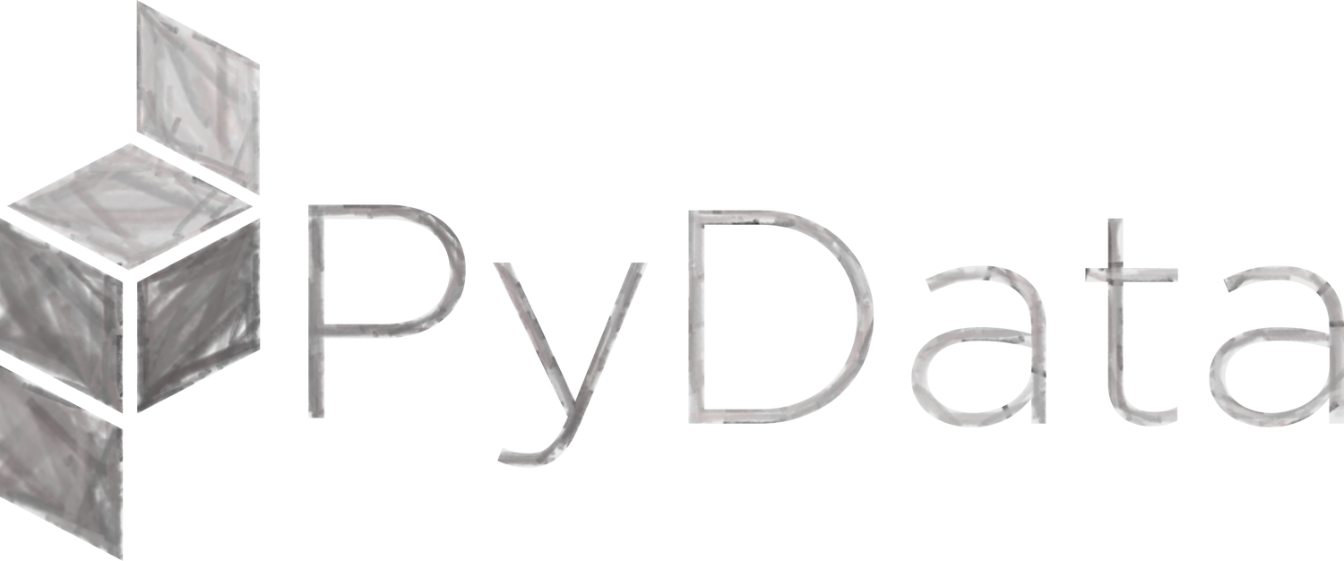
From Ideas to APIs Delivering Fast with Modern Python
How to shorten your path from notebook idea to running API, focusing on the plumbing that actually ships apps and models to production environments.
César Soto Valero
Data Scientist / ML Engineer
cesarsotovalero.net
Notes:
Hello everyone, my name is Cesar. I currently work as a Data Scientist and ML Engineer, and in this session I’m going to talk about how I became a Python-first developer after working for many years in the Java ecosystem for application development and R for data analysis and statistics.
My promise is that by the end of this session, you’ll get an opinionated but genuinely useful blueprint of the frameworks, tools, and workflows that can have a positive impact on your productivity as a Python developer. So, hopefully you’ll get a clear idea on how to go from ideas to working APIs quickly.
So, let’s dive in!

Slide 2
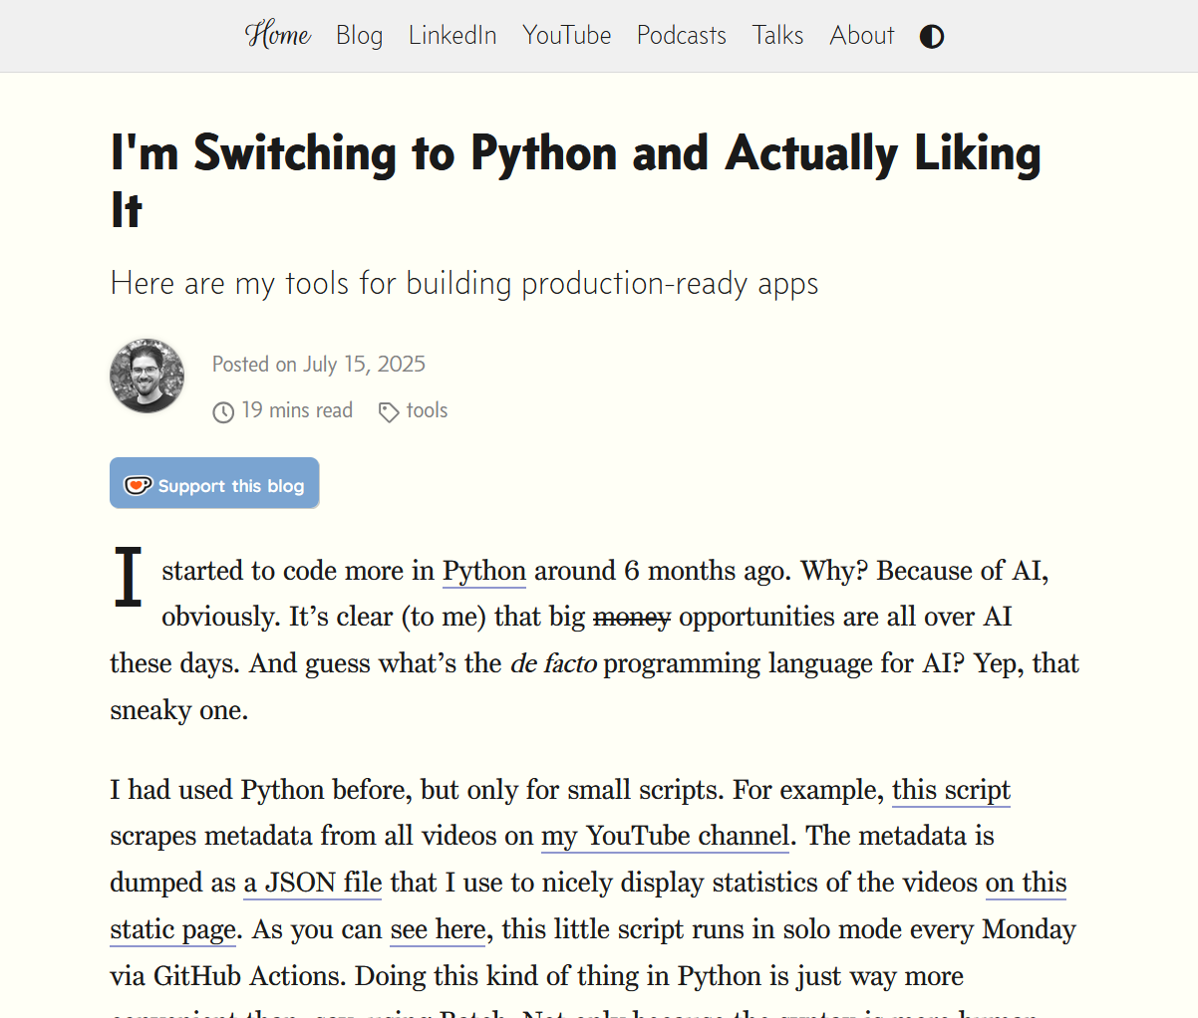
https://www.cesarsotovalero.net/blog/i-am-switching-to-python-and-actually-liking-it.html
c
cesarsotovalero.net
Notes:
So, for context, in mid July of this year I wrote a blog post titled “I’m switching to Python and actually liking it”.
- The idea of the blog post was to share my learnings when working only with Python after transitioning from a Data Engineering oriented role to a Data Scientist.
And this blog post is basically a list of the tools that I used for fast prototyping of applications and ideas, and also the stack that it’s needed to ship modern applications faster without compromising software engineering good practices.
In particular, I was interested in reducing the gap between notebook experiments and deployed services in production.

Slide 3
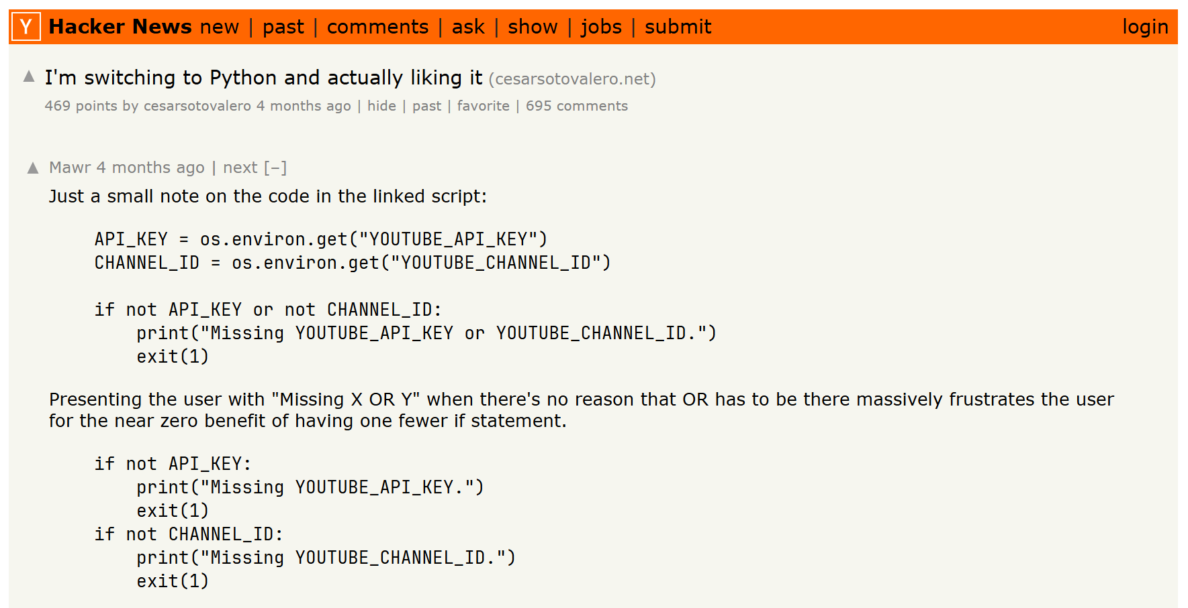
https://news.ycombinator.com/item?id=44579717
cesarsotovalero.net
Notes:
To my big surprise, the blog post resonated well with practitioners across languages and backgrounds.
It received quite a lot of attention on Hacker News. It was actually in the top page for a while.
- And many developers commented about it, well… it actually received 695 comments in total.
This is proof that the Python ecosystem is quite vibrant, and this is also a proof for me that you really never know what the people on the internet are going to find interesting.

Slide 4
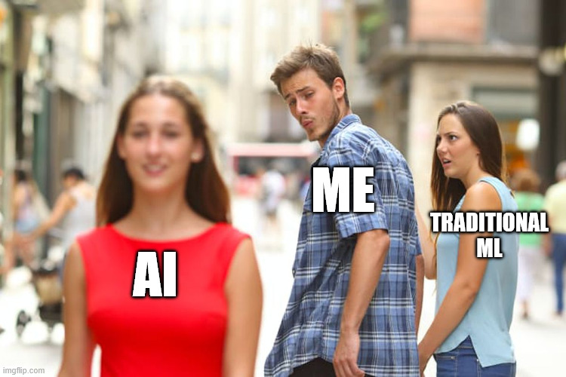
Notes:
But one thing I find very interesting these days is AI.
After been working in traditional Machine Learning for a while, I see AI is this new hot thing going on, that I really want to learn and try and get hands-on with it, for real.
?And guess which is the de-facto programming language for AI development?

Slide 5
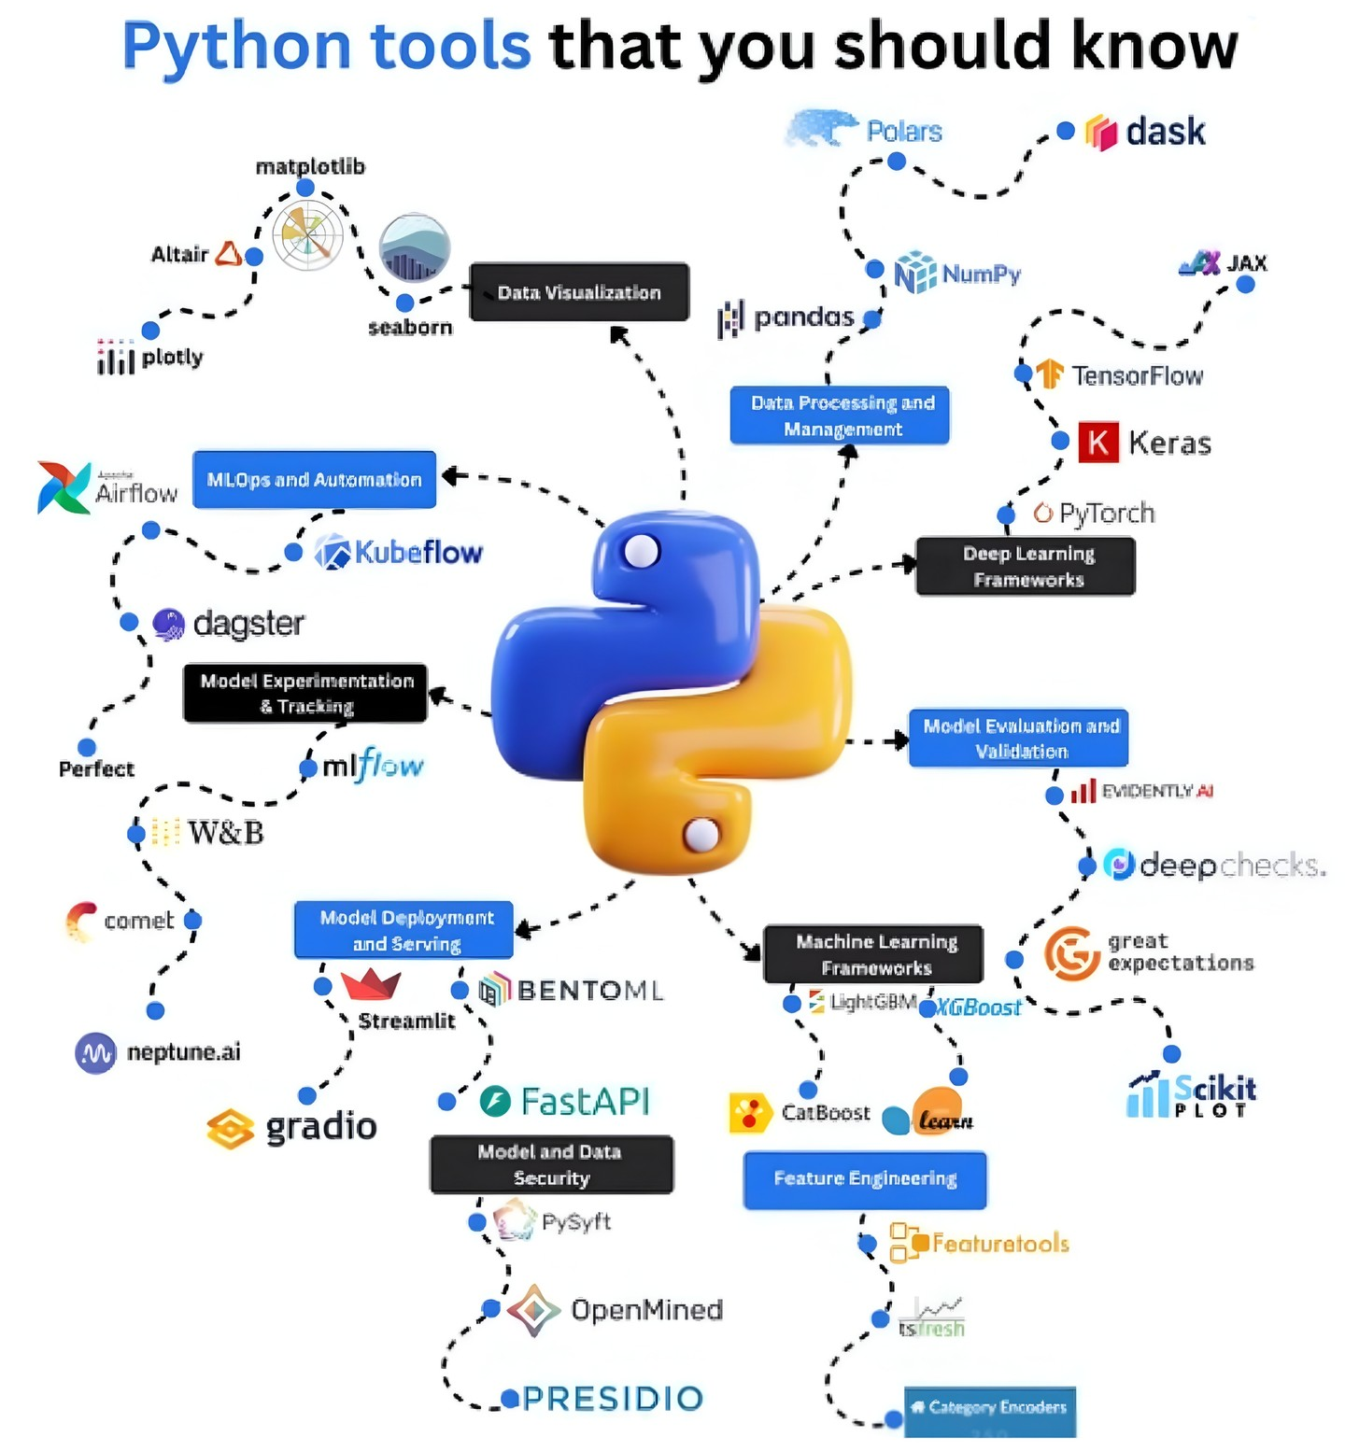
cesarsotovalero.net
Notes:
Yes, it’s Python.
And the thing is that the Python ecosystem is already full of tools for machine learning, MLOps, Data Visualization, Data Processing and so on.

Slide 6
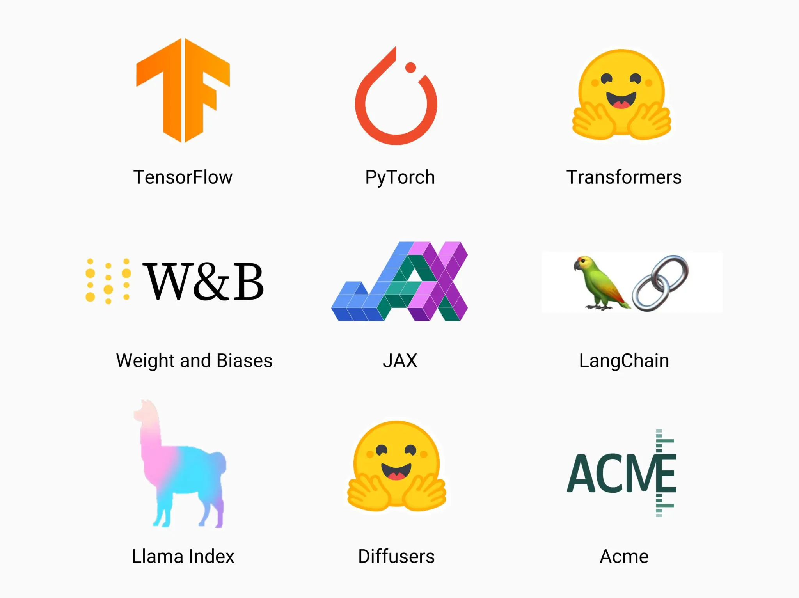
cesarsotovalero.net
Notes:
And with Generative AI there are many more tools and frameworks joining the party.
So, it’s very easy to get lost in this big ecosystem and it’s also difficult to know where to start.

Slide 7

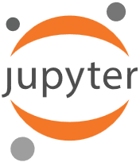
Most Notebooks Never Survive The Real World!
cesarsotovalero.net
Notes:
And for many of us, the natural place to start is with a Jupyter notebook. It’s very convenient; we all know the pattern.
- You get a question to answer or an interesting problem to explore, you collect some data, build a pandas dataframe, produce a chart, and fell happy about it because it’s very visual.
But the problem appears when you are asked to productionize the notebook. The issue is that notebooks are not designed for this.

Slide 8
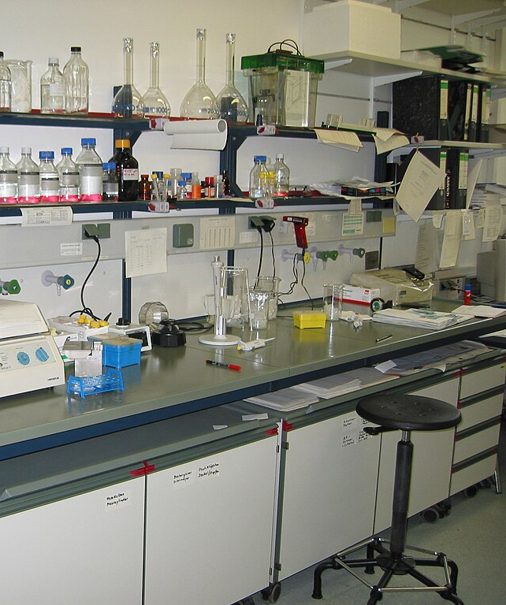
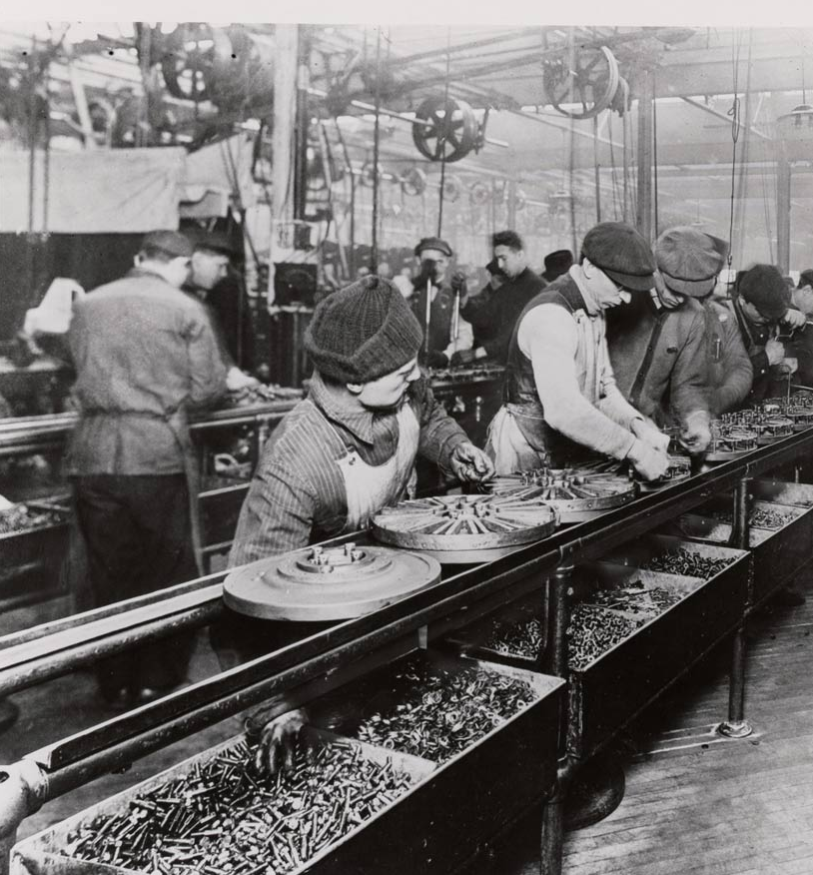
Notes:
I think of notebooks as the lab environment and applications as production-ready product lines in a factory.

Slide 9
Most notebooks never survive the real world
The Screenshot Trap
Endless Tweaks
Missing Infrastructure
You answer the business question, screenshot the chart for Slack, and the repository quietly rots. Analysis complete, value delivered once, code forgotten.
Stakeholders ask for "just one more adjustment" forever. Without structure, every tweak means hunting through notebooks and manually re-running cells in the right order.
No tests to catch regressions, no reproducible environments, no API endpoints, no path to adoption. The insights exist only in your local machine.
Our real bottleneck isn't model accuracy or algorithm choice, it's the plumbing that transforms analysis
into production systems.
cesarsotovalero.net
Notes:
For example, it has happened to me before that I was doing a quick notebook just to get some numbers, and then I forgot about it. One or two months later, when I was asked about the same numbers, I couldn’t find them.
- Or the well-known issue of re-running cells and getting lost because we were in a hurry and broke the order of execution.
- Another issue with notebooks is that it’s hard to create unit tests for the functions, and it’s not possible to build proper application infrastructure. And don’t get me wrong — notebooks are great for exploration and quick data analysis. The problem is that we often treat them as the end of the story.

Slide 10
But AI will write most of the code, right? 🤔
Notes:
And today, with the power of AI, it’s very easy to fall into the trap of thinking that AI will write most of the code and that it will be easy to transpile from notebooks to production-ready code.

Slide 11
Well, not really. 🙂
Notes:
But well,… not really.
Even assuming that code assistants can write production code directly, we still need human developers who understand what’s going on, who take ownership of the code, and who guide the LLMs in the direction we want.

Slide 12
You need structure 🧱
Notes:
And in this context structure is very important.

Slide 13

Monorepo: One Home For Everything
Single place to search, build, deploy
Atomic changes across backend and frontend
Simplified dependency management
Notebooks beside production code
cesarsotovalero.net
Notes:
In my experience, I found really useful having a monorepo.
This is great for code assistants because they have the whole context in a single place. I put
the backend, frontend, the documentation, and the infrastructure in one repository.
This gives a single mental model for the project and also simplifies the dependency management.
And place the notebooks there also, so it’s easier to “productionize” what we have in the notebooks automatically with LLMs.

Slide 14
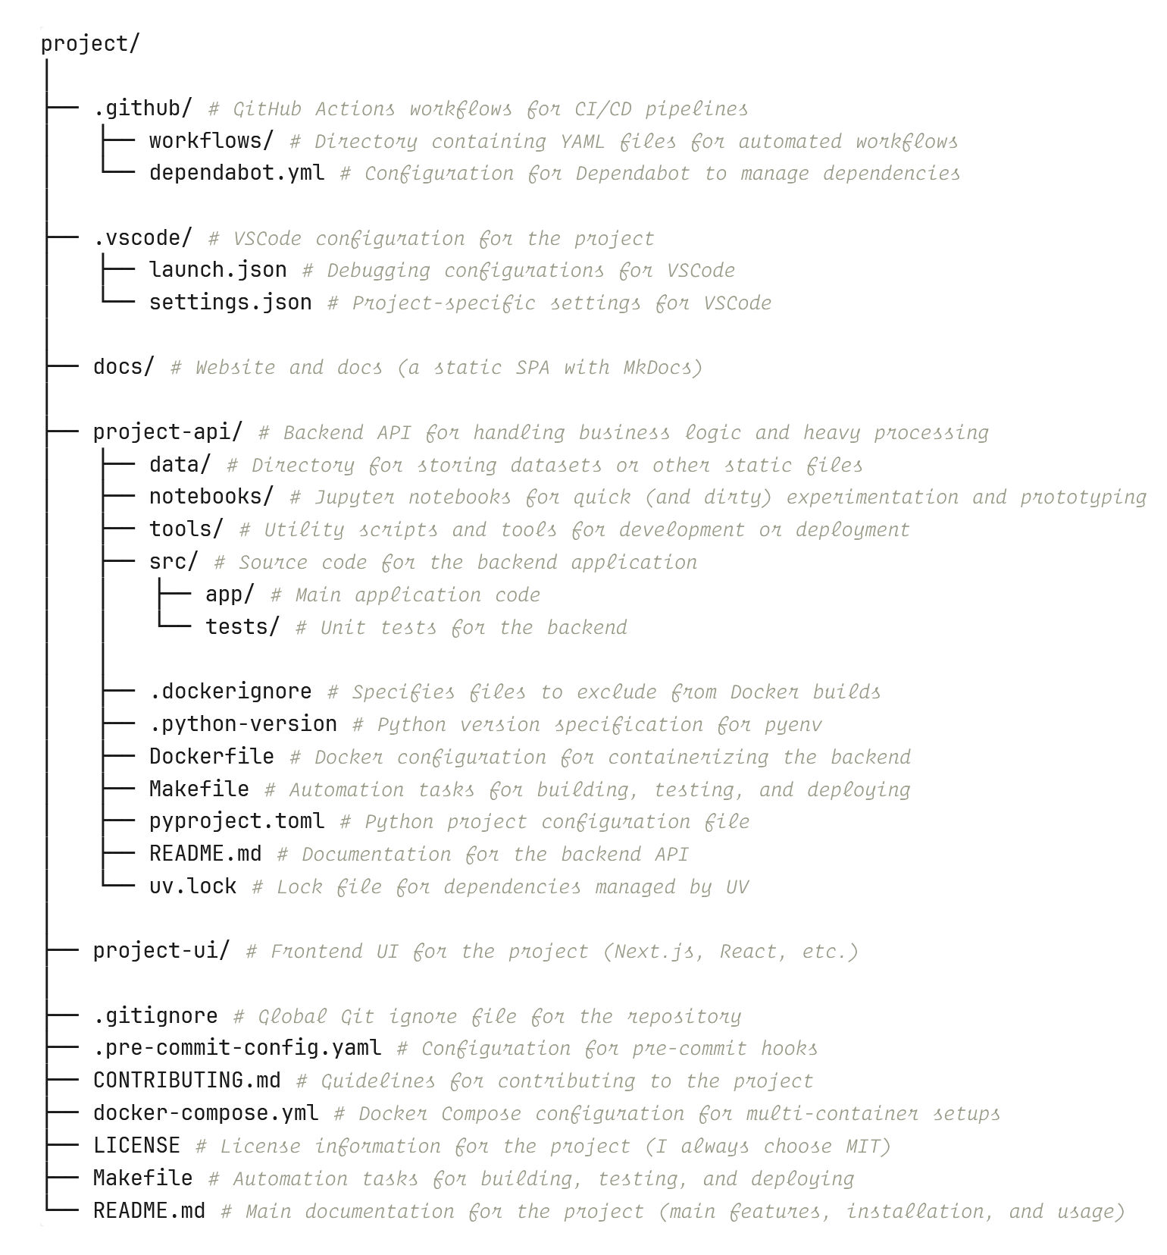
Notes:
Here’s the typical structure of a project with a frontend-backend architecture hosted on GitHub.

Slide 15
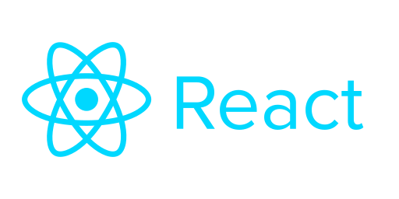
UI components
Notes:
First, I prefer not doing any heavy data processing logic in the ”project-ui”, I prefer to separate the frontend logic from the backend, you can use any framework you like, React, Streamlit, Gradio.

Slide 16
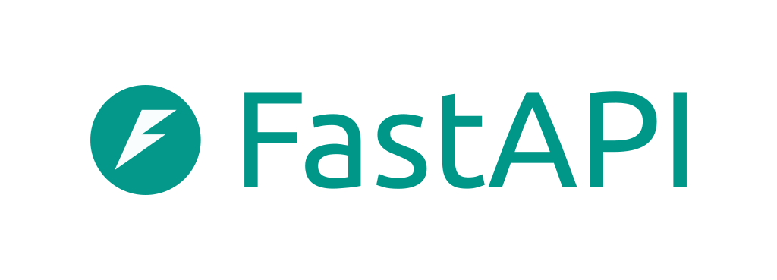
Backend services
Notes:
So, one way to achieve this ist by making HTTP requests to the ”project-api”.
This is the part that contains the Python code that runs the backend services, I use FastAPI for that.
The key insight here to keep the browser application light while delegating the heavy lifting and business logic to the server.

Slide 17
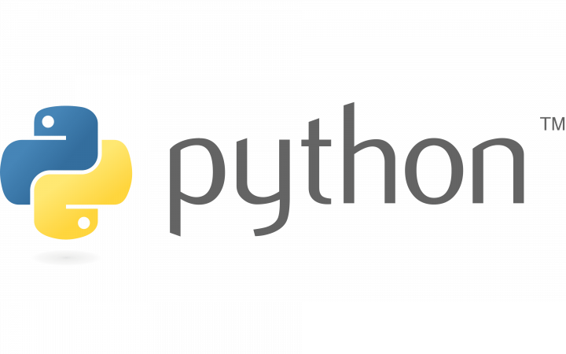
sources, tests, notebooks
scripts, files, etc.
Notes:
Notice that it’s a good idea to include not only the source code and the unit tests in the backend side, but also the notebooks, scripts, and other files that are necessary to build the application.

Slide 18
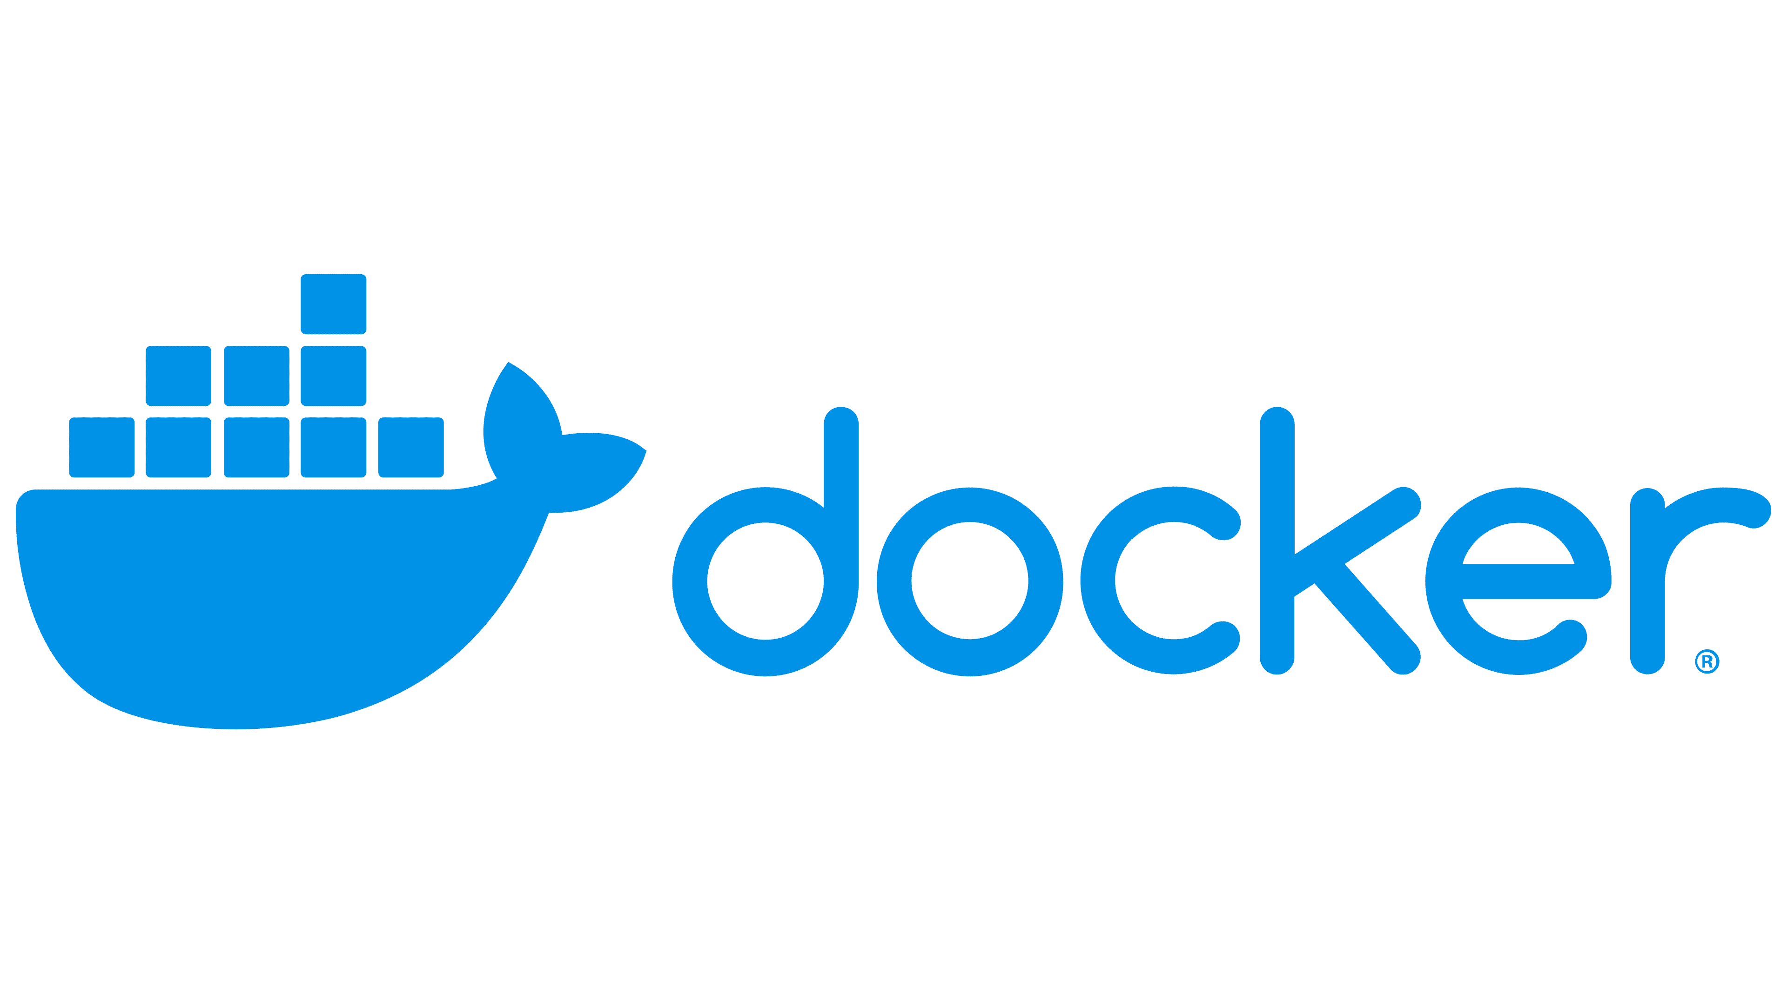
Dependency management, containerization, and documentation
Notes:
And of course, the project-api is a self-contained Python project, so it needs proper dependency management with uv lock files, a Dockerfile for containerization, and a proper readme file.

Slide 19
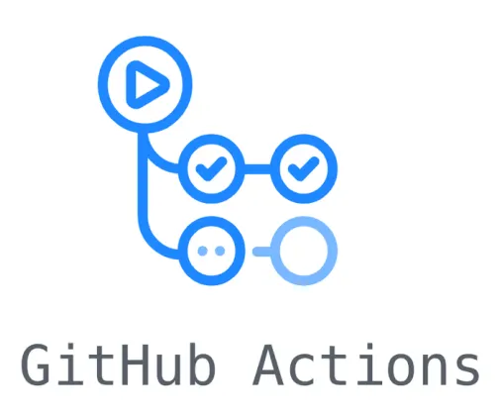
CI/CD pipelines
Notes:
In this example the CI/CD pipeline is handled by GitHub actions. So we’re gonna need this workflows folder.

Slide 20
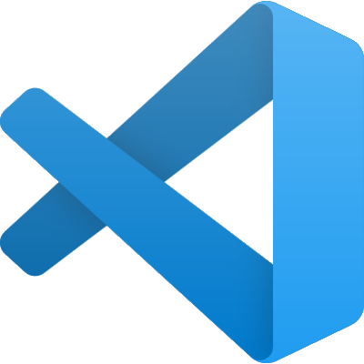
VSCode configs & preferences
Notes:
- I also let some configurations and project specific settings for Visual Studio Code, which is my favorite code editor at the moment.

Slide 21
Other files
Notes:
And of course, not to forget the other files that are commonly placed at the root of a GitHub project like a .gitignore, a Makefile for automating tasks like building, testing, and deployment, and a docker-compose configuration if you want to run the backend and frontend at the same time.

Slide 22
🚀
Notes:
So, there you got it. The same repository handles data analysis, API implementation, documentation, and infrastructure definitions. Everything lives together, reducing context switching and cognitive overhead.

Slide 23
The basic toolbox 🧰
Notes:
So now I’ll go through my current Python toolbox.

Slide 24
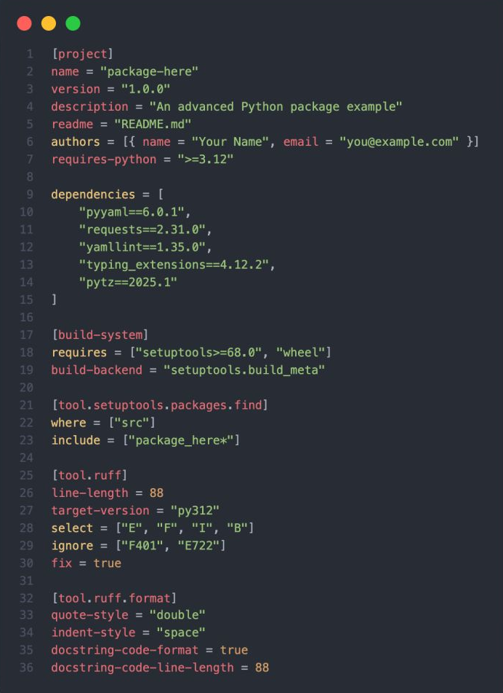



Deterministic environments with uv and pyproject.toml
uv init
One command generates gitignore, virtual environment, pyproject.toml, and lockfile. Everything you need to start clean.
uv add
Centralizes dependency management. No more requirements.txt drift, manual version pinning, or conflicting files across projects.
uv sync
Makes new project reproducible in minutes. Clone repo, run sync, get identical environment. Works for teammates and CI.
The key file is pyproject.toml, your single source of project truth. Dependencies, build configuration, tool settings, and project metadata all live here. One file to understand the entire project setup.
Notes:
Starting with uv, which is by far my favorite Python package manager and build tool. It’s basically all I need to get a deterministic build environment to install and manage dependencies.
There are 3 commands that you need to know: 1) ‘uv init’ to initialize the project, create a virtual environment and the pyproject.toml file (you can see an example of the file on the right side of the slide), this toml file is the most important file because it contains metadata and the list of dependencies required to build and run the project.
2) The “uv add” is used to add dependencies to the project, and the third command is “uv sync” which setups the whole project based on existing config files.
So in general, uv is great for reproducibility.
And the best thing is that it’s super fast.

Slide 25
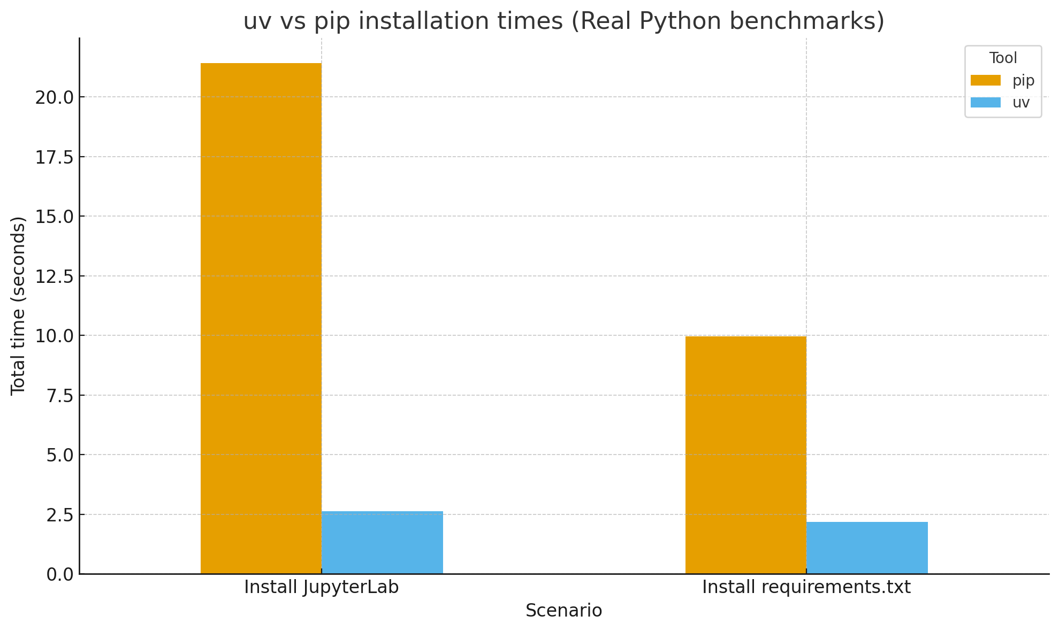
cesarsotovalero.net
Notes:
Actually, I’ve done some benchmarks myself and I found that uv is 8 times faster than pip when installing JupyterLab, and 4 times faster than pip when installing dependencies from the same requirements.txt file.

Slide 26

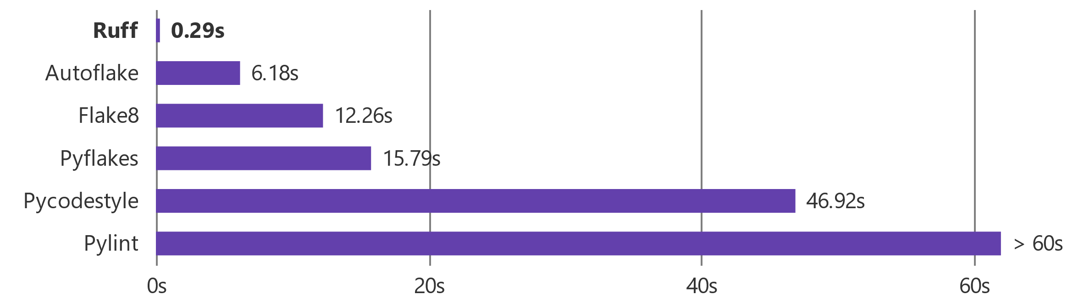
Code linting and formatting with Ruff
ruff check ‘path/to/project’
Lint all files in `/path/to/code` (and any subdirectories)
ruff format ‘path/to/project’
Format all files in `/path/to/code` (and any subdirectories)
Notes:
Well coupled with uv is ruff, which I is actually an emsemble of Python formaters.
Ruff is a linter and code formatter.
It helps to keep our codebases clean and maintainable.
You can configure it within the .toml file and there are basically 2 commands “ruff check” for linting.
And “ruff format” for formatting.
And Ruff has the advantage of being super fast as well, it’s way better than the competitors.

Slide 27
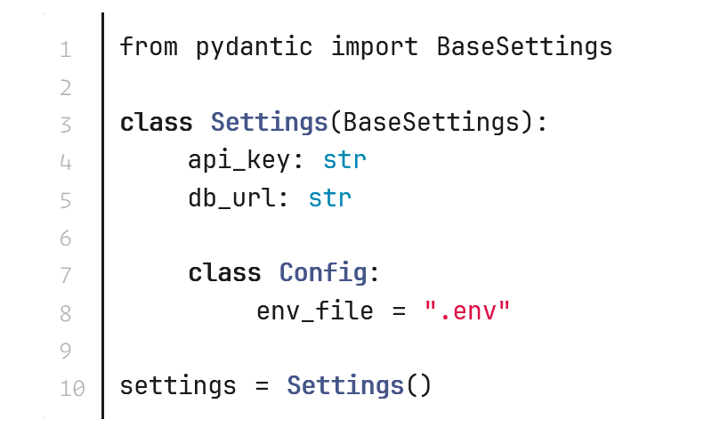
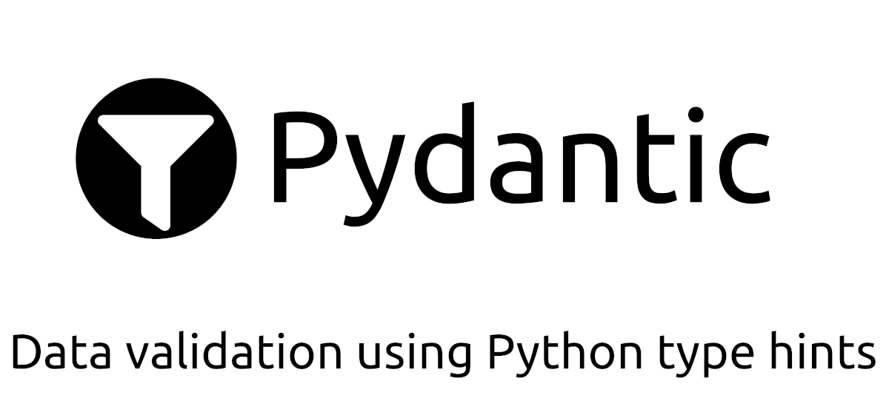
Data validation and settings management with Pydantic
https://docs.pydantic.dev/
Notes:
A popular library that I use is Pydantic, which is a great library for data validation and settings management.
You can manage all kinds of configuration settings with it, such as API keys, database connection details, or model parameters..
- Here’s a small code example on how to use the Pydantic Settings. As you can see, you can automatically load settings from .env files, you can also validate their types, and make them easily accessible in your code.
And so, once you run this code, Pydantic will automatically load the values of ”api_key” and ”db_url”, and these values will be accessible and validated according to the types defined in the Settings model object.

Slide 28
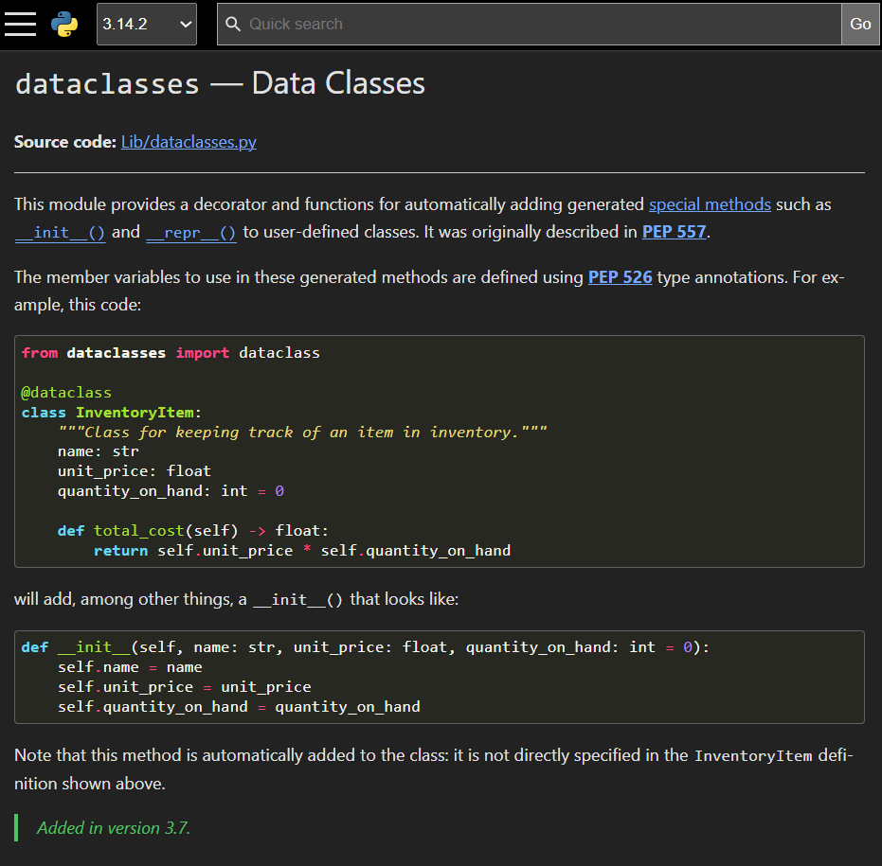
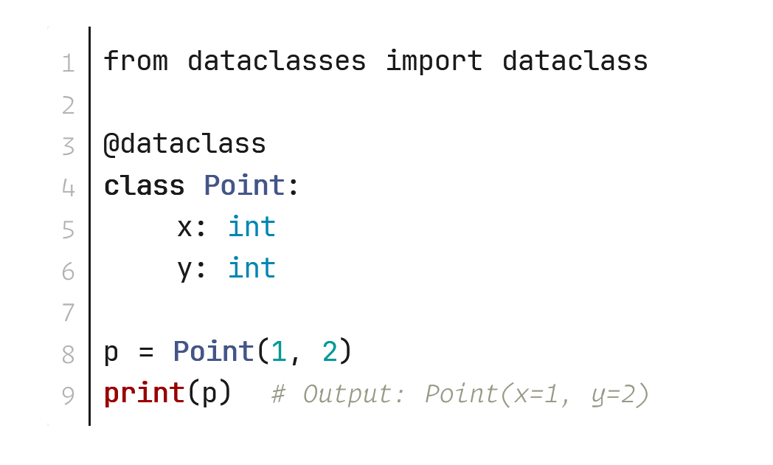
Dataclasses for storing data
Dataclasses offer a simple syntax for creating classes that automatically generate special methods like __init__(), __repr__(), and __eq__().
https://docs.python.org/3/library/dataclasses.html
Notes:
I also want to mention Dataclasses, which is not a library but a modern Python feature that provides a way to define classes that are primarily used to store data.
Here you can see a simple example, just need to import dataclasses from dataclass and you’re ready to use the annotation and get access to special methods like “init” or “eq” which will be generated via metaprogramming for you.

Slide 29
Version control 🔁
Notes:
So now let see other version control tools that complement Git.

Slide 30
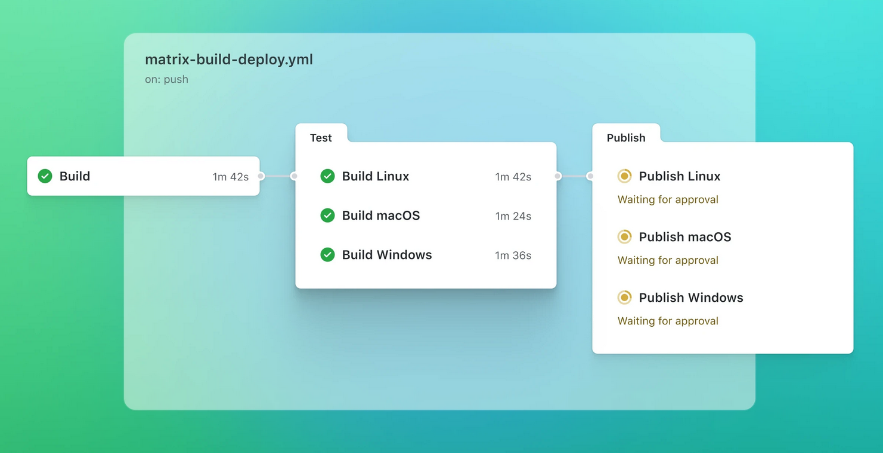
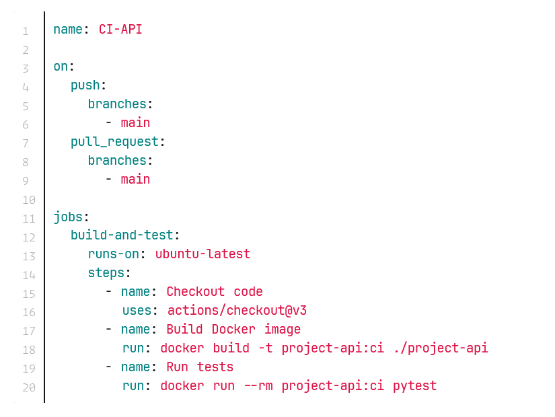
GitHub Actions
Notes:
First, I really love GitHub Actions, I think everyone should use them.
This is a simple code example that compiles and tests the backed of a project.
Note that this workflow uses Docker to run the tests in an isolated environment.
Also note that you can do continuous integration across different operating systems (you can choose from MacOS or Windows if you want)
So I recommend using it for both API and UI pipelines.

Slide 31
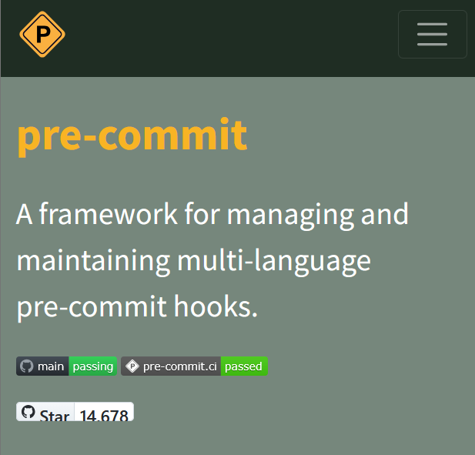
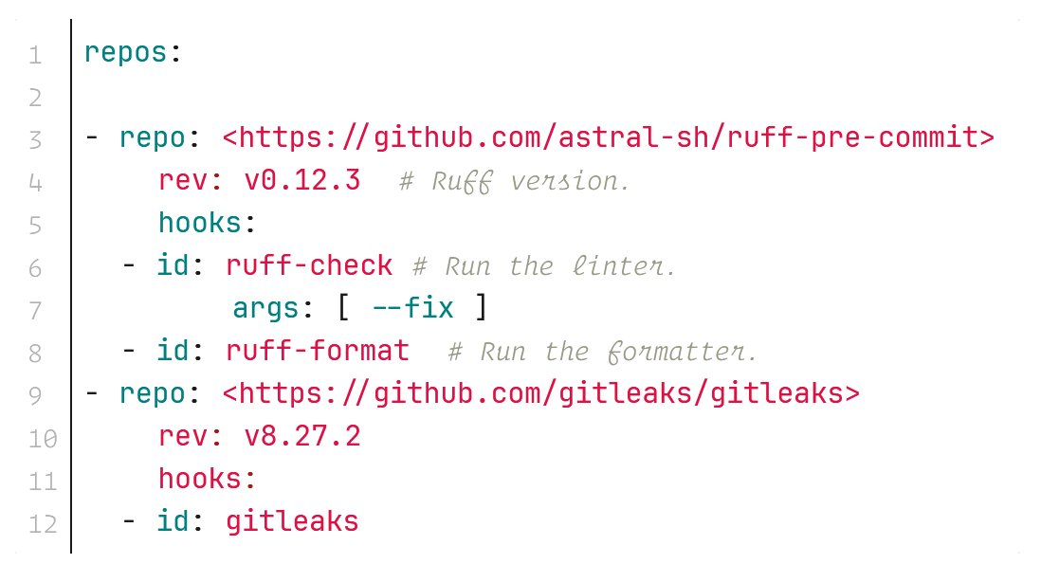
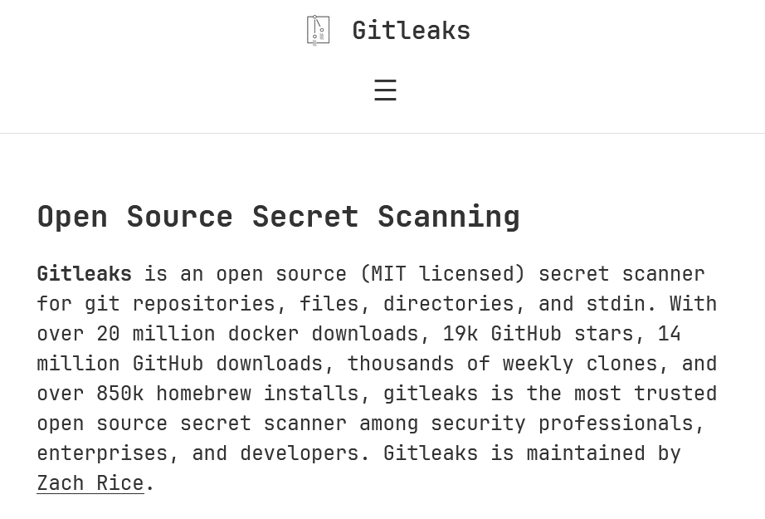
Pre-commit hooks
Notes:
I also use use pre-commit hooks to run checks and format code before committing.
Here’s a sample configuration file that I use.
It helps ensure that the code is always in a good state and follows the project’s coding standards.
For example, I use it to run ruff-pre-commit and gitleaks before committing my code.

Slide 32
Infrastructure Management 🏗️
Notes:
And when it comes to infrastructure management, of course there’s docker, but apart from that.

Slide 33
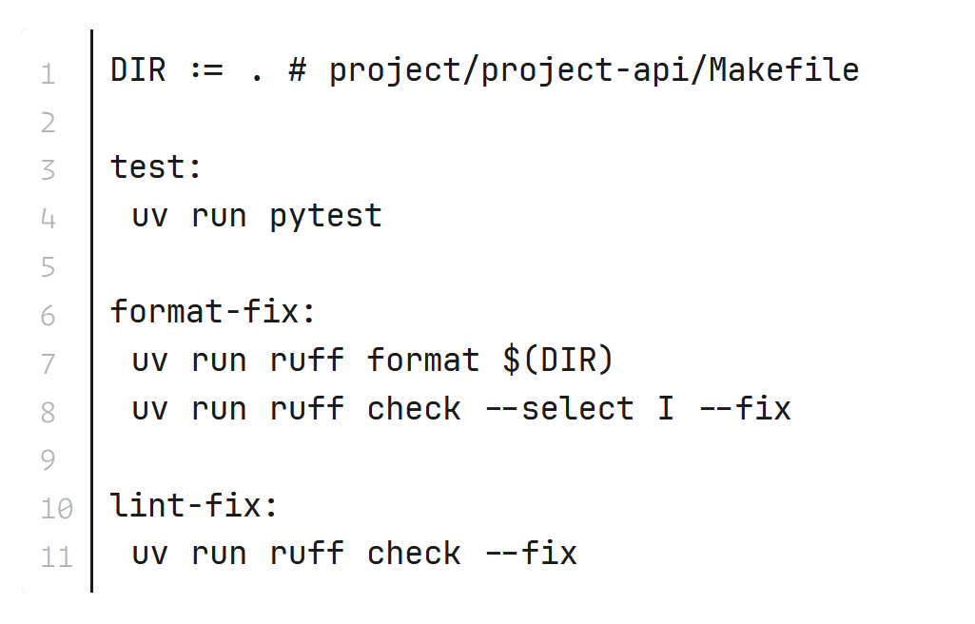
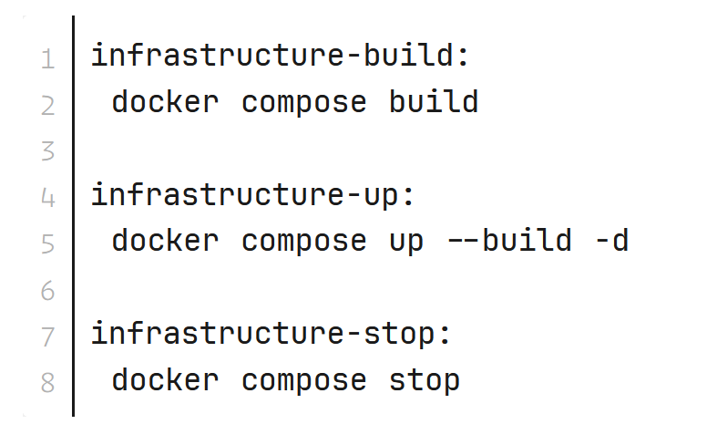
Use make for cheap automation
New contributors learn the entire workflow by reading one tiny Makefile. They don't need to memorize tool flags or hunt through documentation.
Automation is opinionated documentation that actually executes. It captures team conventions and enforces them consistently.
Notes:
I also like to use make, which is a powerful tool that can help you automate almost anything in your development workflow.
I know, these two examples are very simple, but just imagine how you can add more complex tasks as needed.
I prefer using Make to create simple shortcuts for common development commands.
Instead of remembering and typing out long CLI incantations to run tests, build Docker images, or start services, I define these tasks in a Makefile. Then I just run commands like ”make test” or ”make infrastructure-up”, and voila!

Slide 34

Next Step: Build!
1
Commit To One Project
Pick one upcoming project and commit to this toolchain. Real learning happens through applied practice, not passive reading.
2
Start Small
Begin with the skeleton repo and resist yak-shaving for one full week. Ship something imperfect rather than polish something imaginary.
3
Measure Speed
Track time from first business question to first callable endpoint. This metric reveals where your process helps or hinders.
4
Share The Template
Publish your template internally so others skip the suffering. Your documentation of lessons learned becomes the team's shared knowledge.
Notes:
Transitioning fully to Python has been an exciting journey for me, especially because I’ve realized how fast it is to go from an idea to production-ready solutions in Python. It’s really a great and growing ecosystem, especially these days with AI, as we know Python has become the de facto programming language for that.

Slide 35
Q&A
Notes:
So now I’ll go through my current Pyton toolbox.

